Slide 1





HOMELESS SHELTER, AID AND MANAGEMENT SYSTEM
INFO 5100 APPLICATION ENGINEERING AND DEVELOPMENT FINAL PROJECT
-BY
NIYATI SHAH
PIYUSH DANDEKAR
SHAHLA ZAINAB

Slide 2
Objective
To Build an effective system to provision homeless with amenities and also provide them with medical help by connecting them with the hospitals effectively through health care centres.
This applications also helps refugee camps to receive donations and funds from help care organization to help them maintain the homeless shelters.

Slide 3
Workflow
There are mainly 3 workflows which takes place in this system
Health camp workflow
Volunteers Money request workflow
Amenities and inventory workflow

Slide 4

Roles &Responsibilities
Homeless Camp Manager:
Request Amenities from Amenities Provider.
Request Medical camp for Homeless People.
Amenities Provider:
Provide Amenities to refugee camp manager when requested.
Request inventory from Inventory manager.
Inventory Manager:
Provide inventory to Amenities provider when requested.

Slide 5
Roles &Responsibilities
Help Care Volunteer:
Request funds from Money Provider.
Request Medical camp for refugees when a request is received from Homeless camp manager.
Funds Provider:
Provide funds to help care centre when requested.

Slide 6
Roles &Responsibilities
Health Camp Organizer:
Request doctor for availability when a request from help care volunteer is received.
Doctor:
Request lab test from lab assistant.
Assign/Approve a request from medical camp organizer to conduct a medical camp for homeless.
Lab Assistant:
Provide lab test results to doctor when requested.

Slide 7
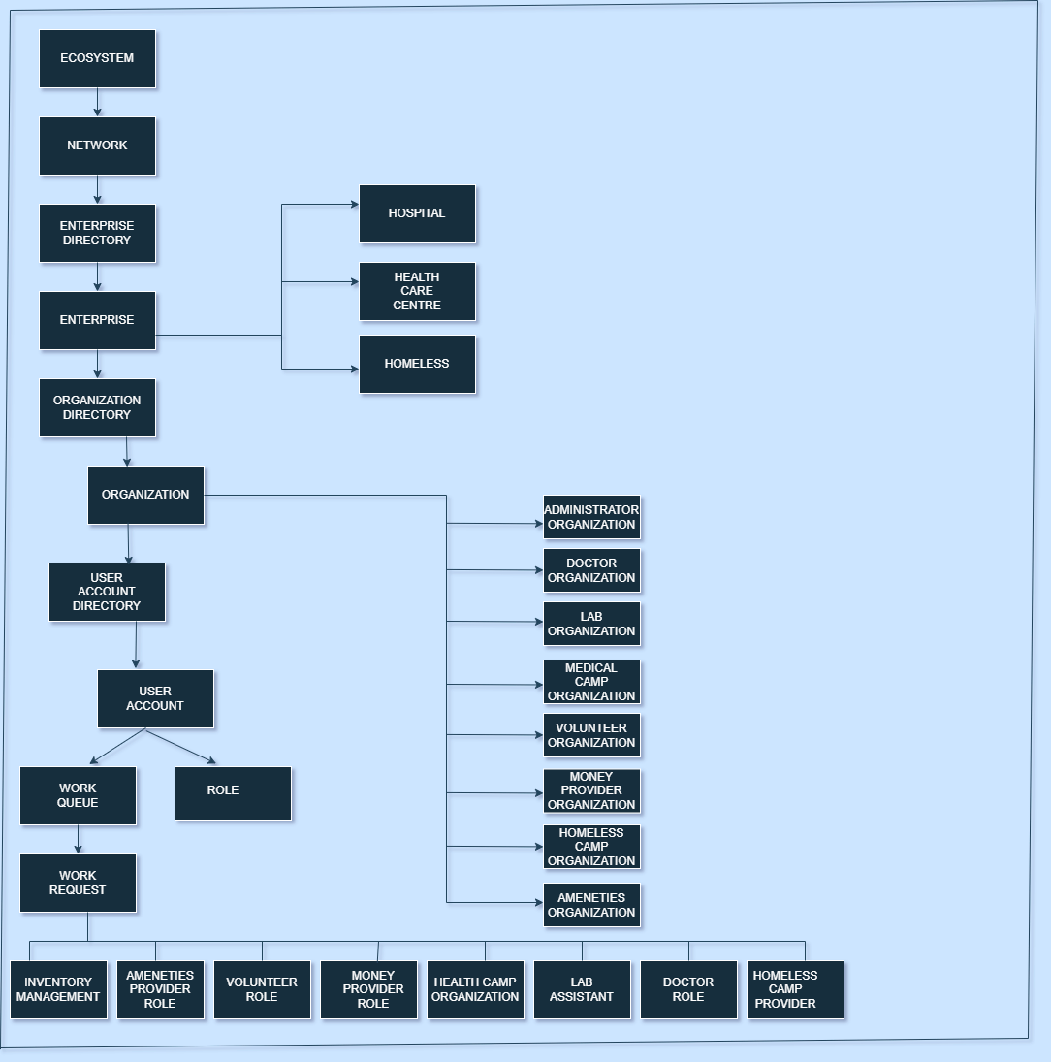
Object Diagram

Slide 8
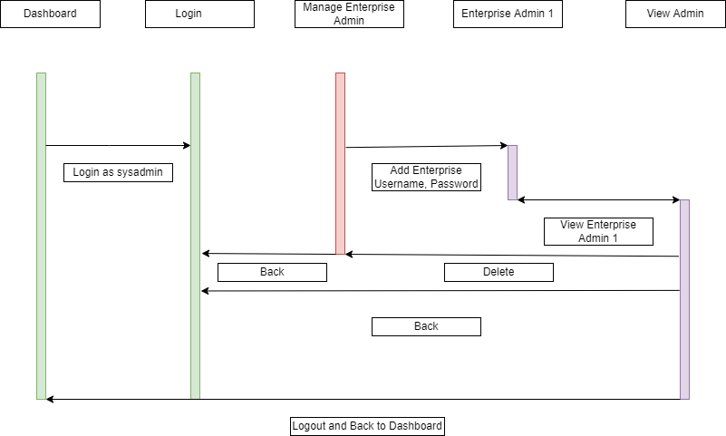
Sequence Diagram Enterprise

Slide 9
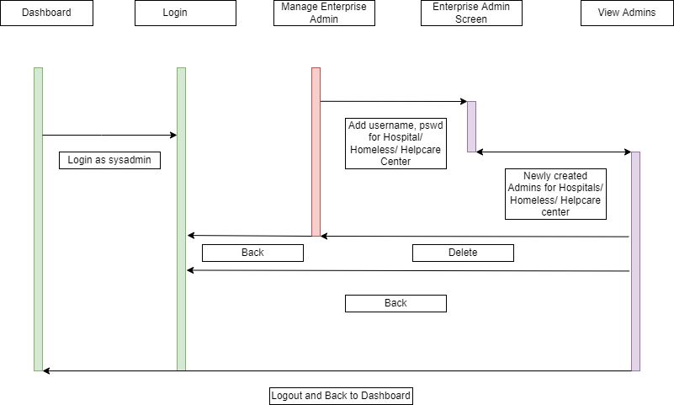
Sequence Diagram Network Admin

Slide 10
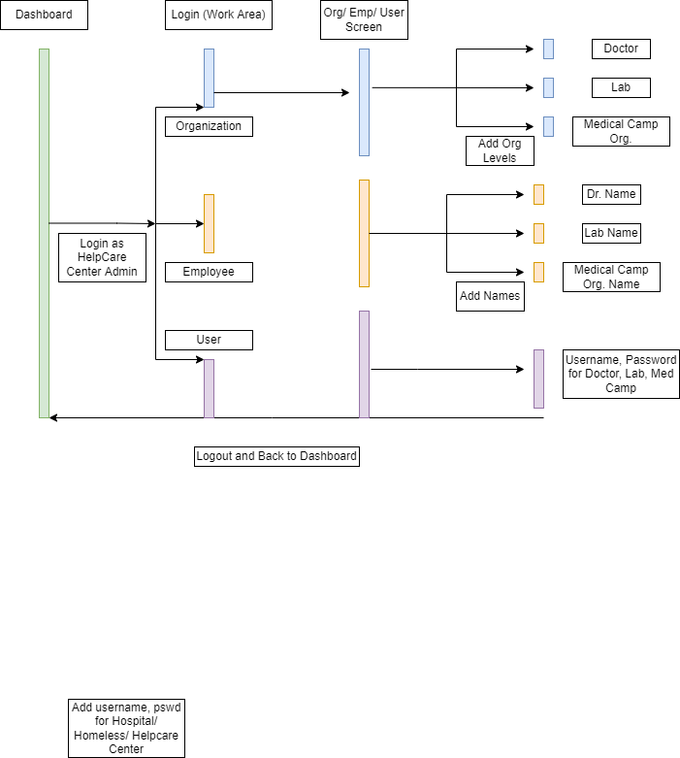
Sequence Diagram Organization

Slide 11
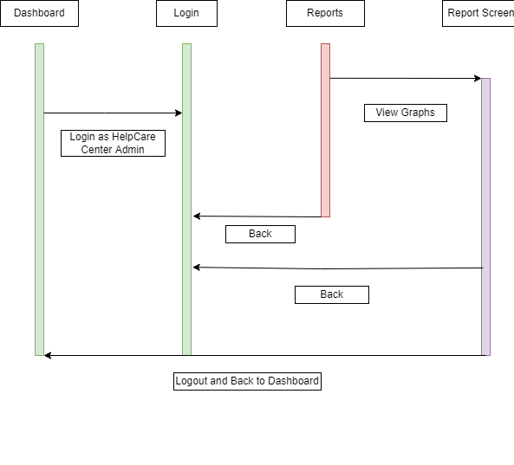
Sequence Diagram Reports

Slide 12

Thank You

